Slide 1
Chapter 5:
Newton’s Laws of Motion
From kinematics, the description of motion, to dynamics, the study of causes of changes in motion.

Slide 2
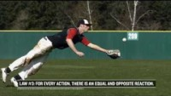
Newton’s Laws of Motion

Slide 3
Helpful Videos
Newton's Laws – Physics Concept Trailer: https://www.youtube.com/watch?v=lCxxH8nQtZQ
Dynamics: What are Forces? https://www.youtube.com/watch?v=iAMxWvyykRU
Newton's First Law of Motion: Mass and Inertia https://www.youtube.com/watch?v=1XSyyjcEHo0
Newton's Second Law of Motion: F = ma https://www.youtube.com/watch?v=xzA6IBWUEDE
Newton's Third Law of Motion: Action and Reaction https://www.youtube.com/watch?v=y61_VPKH2B4&vl=sr
Mass vs. Weight and the Normal Force https://www.youtube.com/watch?v=57gKnA94Doc
Frictional Forces: Static and Kinetic https://www.youtube.com/watch?v=3EbUa5ZDybg

Slide 4
Chapter 5: Outline
5.1 Force and Mass
5.2 Newton’s First Law
5.3 Newton’s Second Law
5.4 Newton’s Third Law
5.5 Common Forces
5.6 Drawing Free-Body Diagrams
5.7 Solving Problems with Newton’s Laws
Concepts
Physics Laws & Formulas
Problem Solving

Slide 5
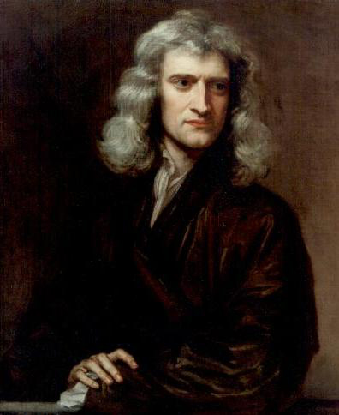
Kinematics vs Dynamics
Kinematics only describes the way objects move — their position, velocity, and acceleration (Chapter 3-4).
Dynamics is the study of how forces affect the motion of objects and systems.
The foundation of dynamics are the laws of motion stated by Isaac Newton (1642–1727).

Slide 6
5.1 Force and Mass
What is force? Scalar or vector?
Does force always involve physical contact?
How do you draw forces acting on an object?
What is mass? Scalar or vector?
Are mass and weight the same?

Slide 7
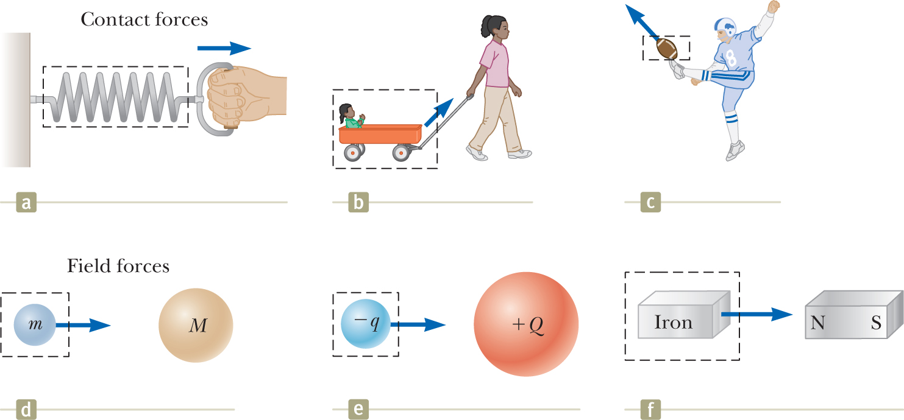
Fundamental Forces
Force refers to interaction with object to change its velocity. We can define force as the push or pull on an object with a specific magnitude and direction.
Contact Forces: involve physical contact between two objects.
Field Forces: no physical contact between two objects → act through empty space (such as electric and magnetic fields).
Notes:
Force can refer to interaction with object to change its velocity (e.g., kicking ball, pushing book away from you on table)
Forces do not always cause motion
Examples:
When sitting → gravitational force acts on your body → you remain stationary
Pushing a large boulder → boulder doesn’t move
What force causes Moon to orbit Earth?
Newton: forces are what cause any change in velocity of object
Moon’s velocity changes in direction as it orbits Earth → change in velocity caused by gravitational force exerted by Earth on Moon
Contact forces: involve physical contact between two objects
When coiled spring pulled → spring stretches
When stationary cart pulled → cart moves
When football is kicked → both deformed and set in motion
Other examples:
Force exerted by gas molecules on walls of container
Force exerted by your feet on floor
Field forces: no physical contact between two objects → act through empty space
Examples:
Gravitational force of attraction between two objects with mass → keeps objects bound to Earth and planets in orbit around Sun
Electric force that one electric charge exerts on another (e.g., attractive electric force between electron and proton that form hydrogen atom)
Force bar magnet exerts on piece of iron
Distinction between contact forces and field forces not sharp → at atomic level, all forces we classify as contact forces caused by electric (field) forces
Convenient to use both classifications of forces

Slide 8


Fundamental Forces
Fundamental forces in nature:
Gravitational forces between objects
Electromagnetic forces between electric charges
Strong forces between subatomic particles
Weak forces that arise in certain radioactive decay processes
Classical physics → only concerned with gravitational and electromagnetic forces
Notes:
Fundamental forces in nature:
Gravitational forces between objects
Electromagnetic forces between electric charges
Strong forces between subatomic particles
Weak forces that arise in certain radioactive decay processes
Classical physics → only concerned with gravitational and electromagnetic forces

Slide 9
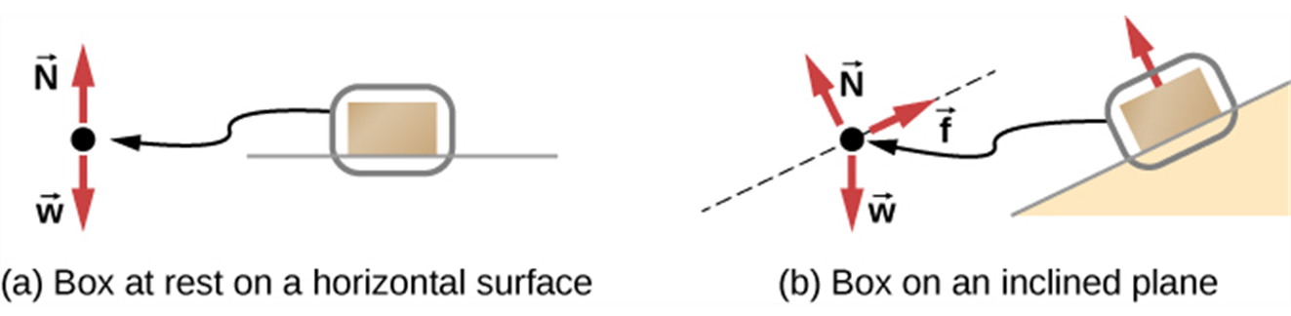
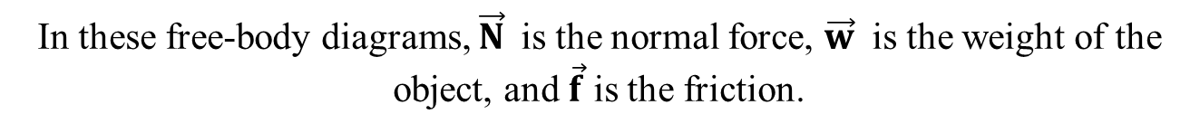
Free Body Diagram (FBD)
Free-body diagram: a sketch showing all external forces acting on an object or system.
Free-body diagrams are useful in analyzing forces acting on an object or system and are employed extensively in the study and application of Newton’s laws of motion.
In these free-body diagrams, $\vec{N}$is the normal force, $\vec{w}$ is the weight of the object, and $\vec{f}$ is the friction.

Slide 10
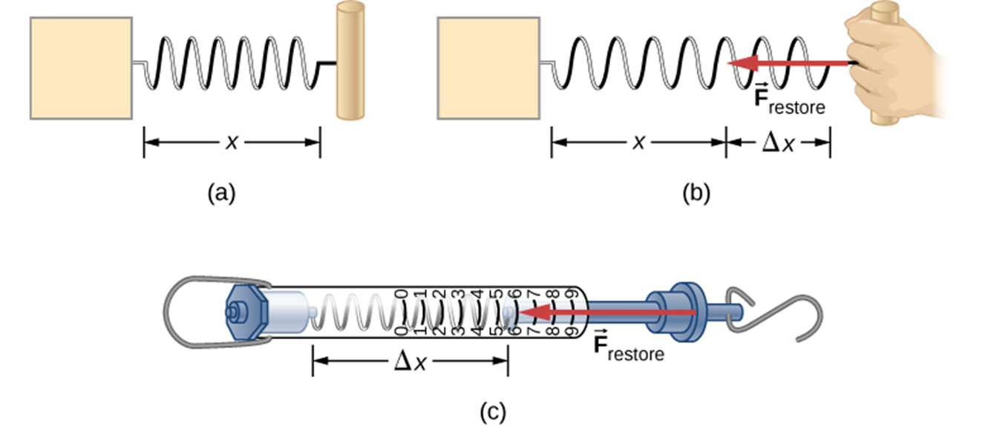
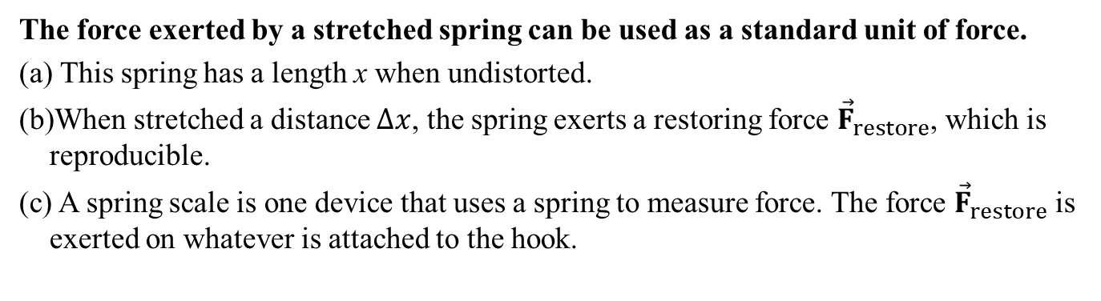
How to measure Force
The force exerted by a stretched spring can be used as a standard unit of force.
This spring has a length x when undistorted.
When stretched a distance $∆x$, the spring exerts a restoring force ${\vec{F}}_{restore}$, which is reproducible.
A spring scale is one device that uses a spring to measure force. The force ${\vec{F}}_{restore}$ is exerted on whatever is attached to the hook.
Notes:
Using deformation of spring to measure force:
Vertical force applied to spring scale (figure (a))
Spring elongates when force applied → pointer on scale reads extension of spring
Calibrate spring by defining reference force F₁ as force that produces pointer reading of 1.00 cm
Now apply different downward force F₂ with magnitude 2F₁ (figure (b)) → pointer moves to 2.00 cm
Combined forces = sum of individual forces (figure (c))

Slide 11
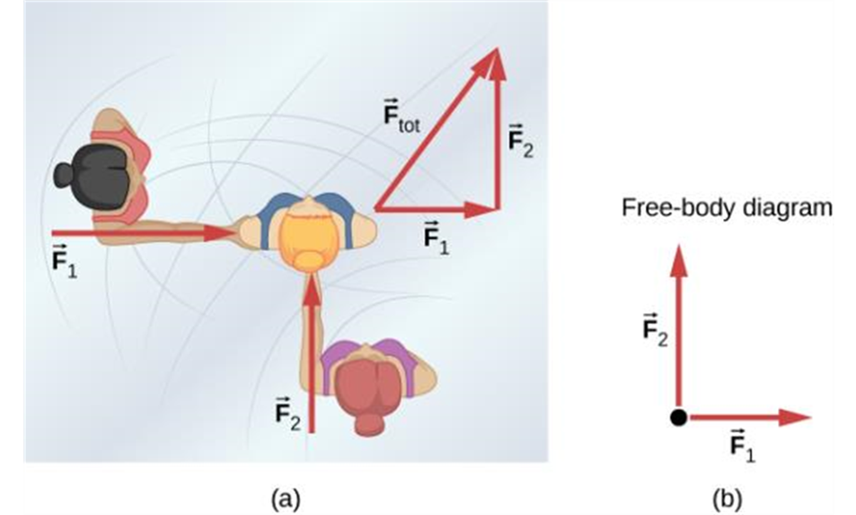
Forces as Vectors
An overhead view of two ice skaters pushing on a third skater. Forces are vectors and add like other vectors, so the total force on the third skater is in the direction shown.
A free-body diagram representing the forces acting on the third skater.

Slide 12
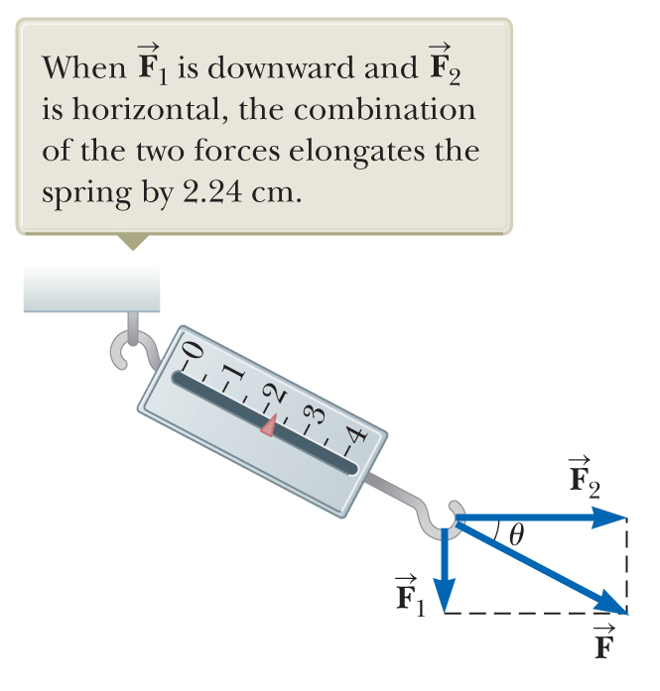
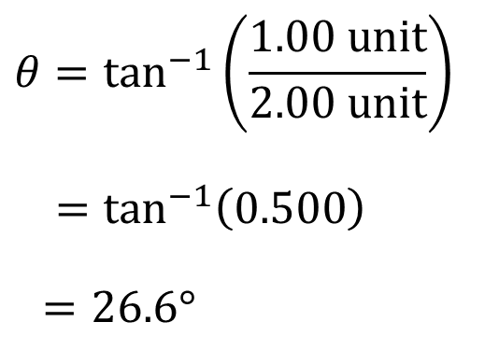
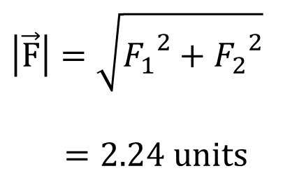
Force: A Vector Quantity
Must use rules of vector addition to obtain the net force on an object.
$$\left|\vec{F}\right|=\sqrt{{F_{1}}^{2}+{F_{2}}^{2}}$$
$=2.24\text{ units}$
$$θ=\tan^{−1}\left(\frac{1.00\text{ unit}}{2.00\text{ unit}}\right)$$
$=\tan^{−1}\left(0.500\right)$
$=26.6°$
Notes:
Force F₁ applied downward, F₂ horizontal (figure)
Pointer reads 2.24 cm
Single force F that would produce same reading = sum of vectors F₁ and F₂ : [click to show equation]
Direction: [click to show equation]
one “unit" is the magnitude of force that would stretch this particular spring by one centimeter
Must use rules of vector addition to obtain the net force on an object

Slide 13
Units of Forces
SI unit of force: newton (N)
Notes:
SI unit of force: newton (N)
Force of 1 N is force that, when acting on object of mass 1 kg, produces acceleration of 1 m/s²
U.S. customary system: unit of force: pound (lb)
Force of 1 lb = force that, when acting on 1-slug mass, produces acceleration of 1 ft/s^{2.}
Convenient approximation: [click to show equation]

Slide 14
Mass
Mass is a property that specifies how much resistance an object exhibits to changes in its velocity.
Experiments show: greater the mass of an object → less that object accelerates under action of given applied force.
Magnitude of acceleration of object inversely proportional to its mass when acted on by a given force.
Mass is a scalar quantity (SI unit: kg) and inherent property of an object, independent of the object’s surroundings and of method used to measure it.
Notes:
Mass: property that specifies how much resistance object exhibits to changes in its velocity
Experiments show: greater the mass of an object → less that object accelerates under action of given applied force
Experiments to compare accelerations given force produces on different objects
Force acting on object of mass m₁ produces acceleration a₁
Same force acting on object of mass m₂ produces acceleration a₂
Ratio of two masses = inverse ratio of magnitudes of accelerations: [click to show equation]
Example: Force acting on 3-kg object produces acceleration of 4 m/s² → same force applied to 6-kg object produces acceleration with half the magnitude: 2 m/s²
Magnitude of acceleration of object inversely proportional to its mass when acted on by given force
If one object has known mass: mass of other object can be obtained from acceleration measurements
Mass → inherent property of object, independent of object’s surroundings and of method used to measure it
scalar quantity
Mass and weight are different!
Weight of object = magnitude of gravitational force exerted on object, varies with location
E.g., person weighing 180 lb on Earth weighs ≈ 30 lb on Moon
Mass of object is same everywhere
E.g., object having mass of 2 kg on Earth also has mass of 2 kg on Moon

Slide 15
Inertial Frame of Reference
If an object does not interact with other objects, it is possible to identify a reference frame in which the object has zero acceleration.
Inertial frame of reference
We model Earth as inertial frame, along with any other frame attached to it in our course.
Video 1: https://www.youtube.com/watch?v=wD7C4V9smG4
Video 2: https://www.youtube.com/watch?v=8xiIP2B6L3M
Notes:
Recall moving object can be observed from any number of reference frames
Newton’s first law of motion (law of inertia) defines special set of reference frames: inertial frames. (text on slide)
This reference frame = inertial frame of reference [click to show text]
When puck on air hockey table located on ground
Inertial reference frame: no horizontal interactions of puck with any other objects, puck has zero acceleration in that direction
When you are on train moving at constant velocity:
Also observing puck from inertial reference frame
Any reference frame that moves with constant velocity relative to inertial frame is itself inertial frame
When you and train accelerate → observing puck from noninertial reference frame
You and train accelerating relative to inertial reference frame of Earth’s surface
According to you: puck appears to be accelerating
But: reference frame where puck has zero acceleration
Observer standing outside train on ground sees puck sliding relative to table but moving with same velocity with respect to ground as train had before it started to accelerate
Newton’s first law still satisfied even though your observations as rider on train show an apparent acceleration relative to you

Slide 16
5.2 Newton’s First Law
Group Discussion:
What are the Newton’s Laws of Motion?
What is the equation for Newton’s Second Law? What are the quantities in the equation? Is it a vector or scalar equation?
Are Newton’s Laws of Motion consistent with or contradicting our daily life experience?

Slide 17

5.2 Newton’s First Law
A body at rest remains at rest or, if in motion, remains in motion at constant velocity unless acted on by a net external force.
When no net force acts on an object, the acceleration of the object is zero (rest or constant velocity).
Inertia: the tendency of an object to resist any attempt to change its velocity.
Notes:
Practical statement of Newton’s first law of motion (text on slide)
When no force acts on an object, the acceleration of the object is zero
Any isolated object (one that does not interact with its environment) either at rest and stays at rest, or moving with constant velocity
Inertia: tendency of object to resist any attempt to change its velocity
Accelerating object must be experiencing force
Define force as that which causes a change in motion of an object

Slide 18
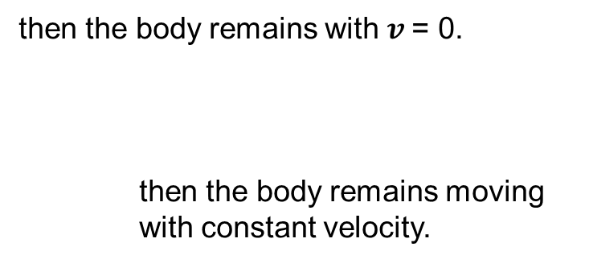

Newton’s First Law
If${\vec{F}}_{net}$= 0 (no net force acting on the body)
and the body is a rest
and the body is moving with constant velocity
v
v
Even today people still believe that a force is required to keep an object moving.

Slide 19
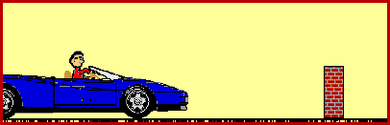
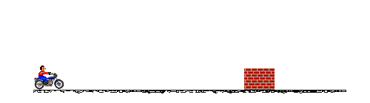
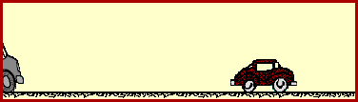
Accidents
Inertia is tendency of an object to change its velocity.
It is related to mass.
The bigger the mass, more resistance to changes in the motion.

Slide 20
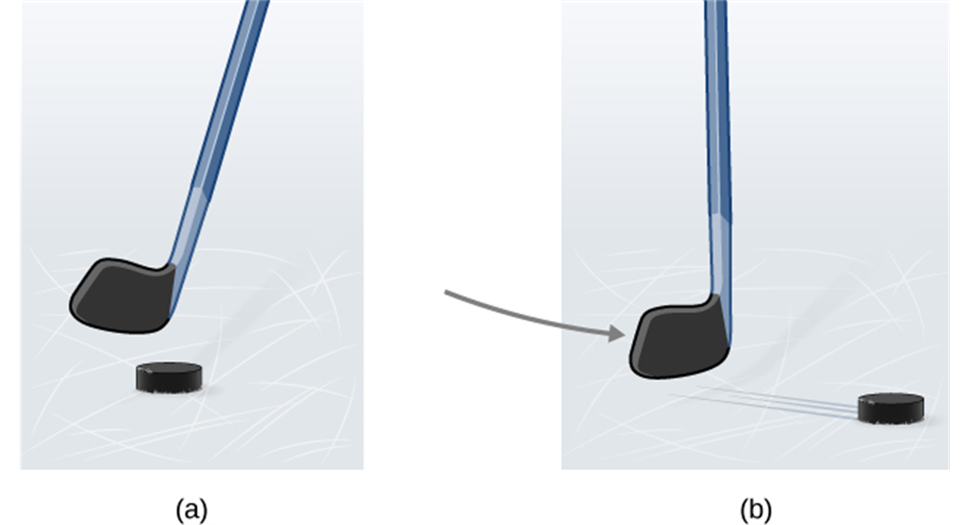
NOT contradicting our experience
Friction or resistance everywhere!
A hockey puck is shown at rest; it remains at rest until an outside force such as a hockey stick changes its state of rest;
A hockey puck is shown in motion; it continues in motion in a straight line until an outside force causes it to change its state of motion. Although it is slick, an ice surface provides some friction that slows the puck.

Slide 21
CQ#1
If you fire a bullet in space, what will eventually happen to the bullet?
It will slow down and come to a stop
It will get faster and faster
It will keep travelling until it hits something

Slide 22

Newton’s First Law: Hockey Puck

Slide 23
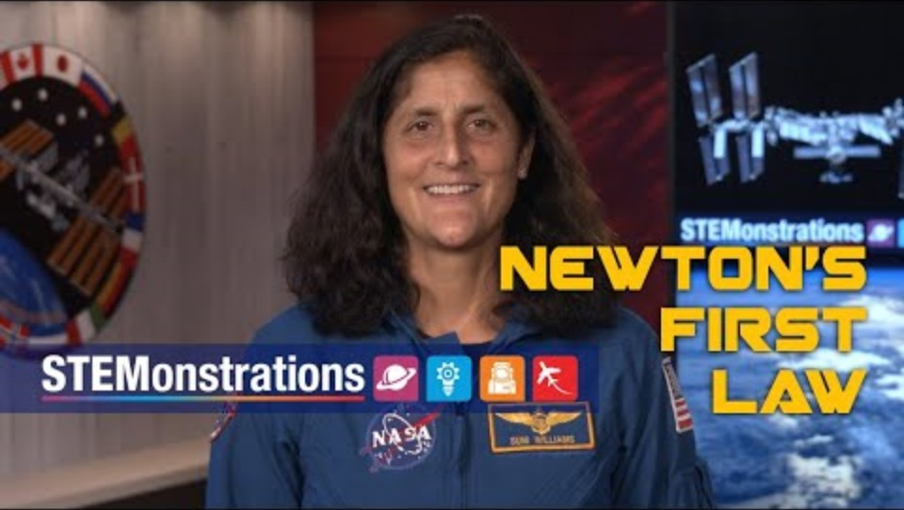
Newton’s First Law: Space Station
Newton’s First Law

Slide 24
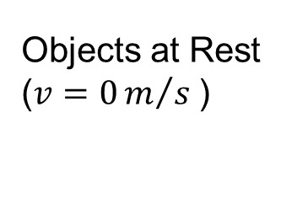
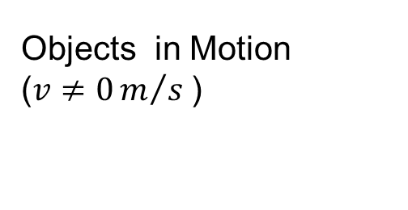
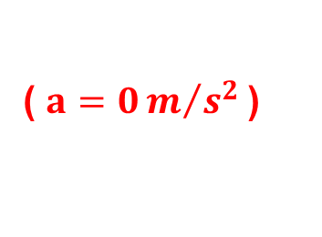
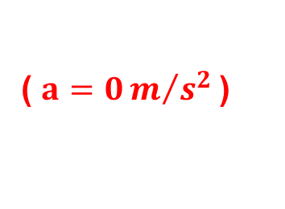

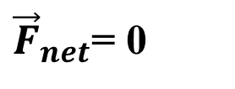


Newton’s First Law
Net force ZERO (${\vec{F}}_{net}$= 0 ) described by the 1st Law of Newton.
${\vec{F}}_{net}$= 0
Stay at Rest
Stay in Motion
(same speed and direction)
What does “${\vec{F}}_{net}$= 0 ” mean??
acceleration = 0 if ${\vec{F}}_{net}$= 0

Slide 25
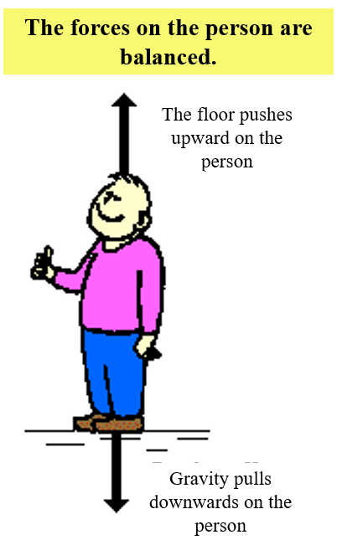
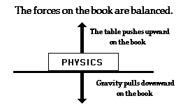

Newton’s First Law
Net force ZERO (${\vec{F}}_{net}$= 0 ) described by the 1st Law of Newton.
The forces on the book are balanced.
The table pushes upward on the book
Ɵ
Gravity pulls downward on the book
What if a Force (F) is applied at an angle?

Slide 26
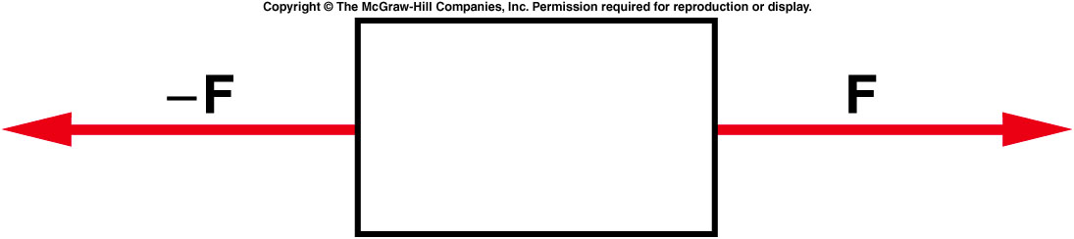
Two equal-magnitude horizontal forces act on a box. Is
the object accelerated horizontally?
Yes
No
You can’t tell from this diagram.

Slide 27
Two equal-magnitude horizontal forces act on a box. Is
the object accelerated horizontally?
Yes
No
You can’t tell from this diagram.
Since the two forces are equal in size, and are in opposite directions, they cancel each other out and there is no acceleration.

Slide 28
Is it possible that the box is moving, when two forces equal in size but opposite in direction are applied?
Yes , it is possible for
the object to be moving.
b) No, it is impossible for
the object to be moving.

Slide 29
Is it possible that the box is moving, when two forces equal in size but opposite in direction are applied?
Yes , it is possible for
the object to be moving.
b) No, it is impossible for
the object to be moving.
Even though the forces cancel each other, it is possible that the object is moving at constant speed.
Even today people still believe that a force is required to keep an object moving.

Slide 30
5.3 Newton’s Second Law
m₁
The smaller-mass object experiences a larger acceleration than the larger-mass object when identical forces are applied to the two objects.
F
a
m₂
F
a
Notes:
Newton’s first law explains what happens to object when no forces act on it: maintains original motion (either remains at rest or moves in straight line with constant speed)
Newton’s second law answers question of what happens to object when one or more forces act on it
Imagine pushing block of mass m across frictionless, horizontal surface
Horizontal force F on block → moves with acceleration a
Apply force twice as great on same block → acceleration of block doubles
Acceleration of object directly proportional to force acting on it, inversely proportional to mass: [click to show equation]

Slide 31
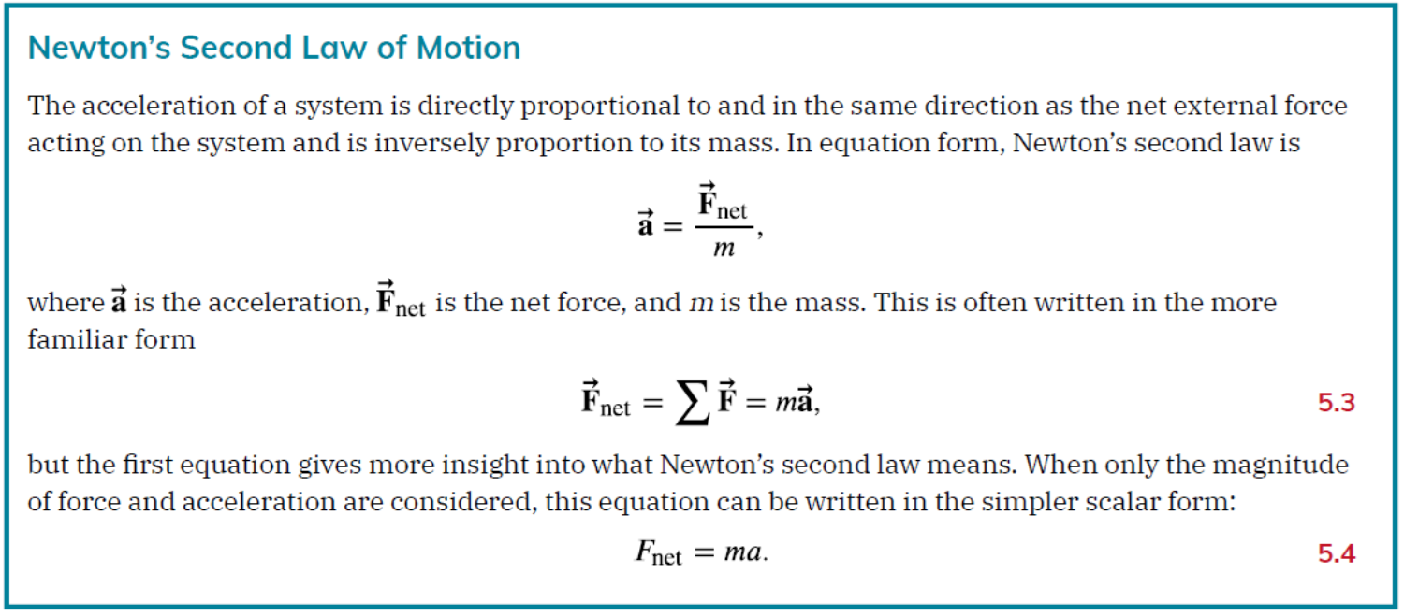
5.3 Newton’s Second Law
5.3 Newton’s Second Law

Slide 32
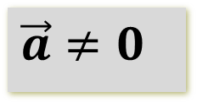

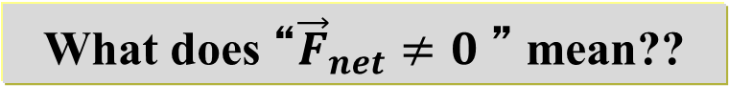
5.3 Newton’s Second Law
Net Force non-zero (${\vec{F}}_{net}≠0$ ) as described by the 2nd Law of Newton.
Net-Force non-zero
There is an acceleration
The acceleration depends directly upon the
“ net force”
The acceleration depends inversely upon the
“object’s mass”
What does “${\vec{F}}_{net}≠0$ ” mean??
$$\vec{a}≠0$$

Slide 33
Component Form of Newton’s Second Law
This vector equation can be written as three component equations:
Use Component Form equations when solving problems.

Slide 34
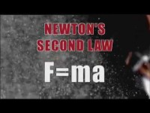
Newton’s Second Law: Hockey Puck

Slide 35
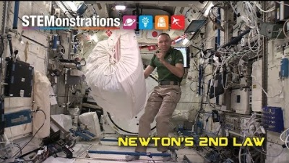
Newton’s Second Law
Newton’s Second Law: Space Station

Slide 36
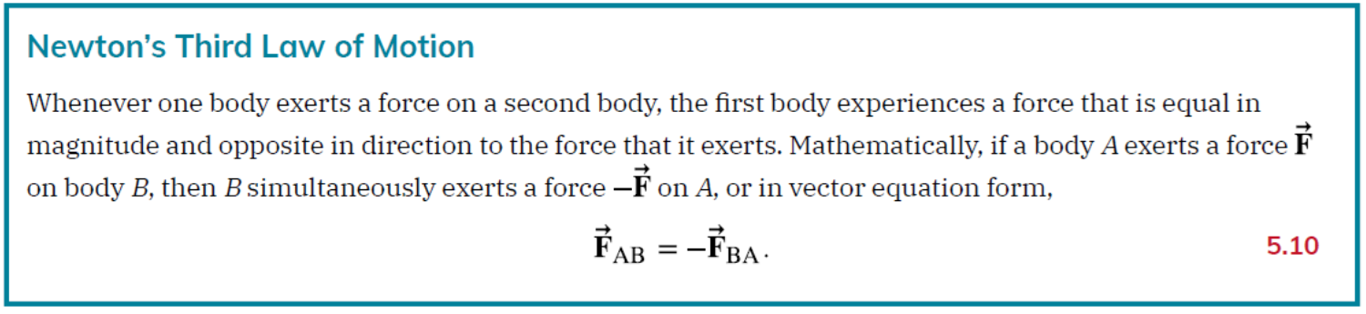
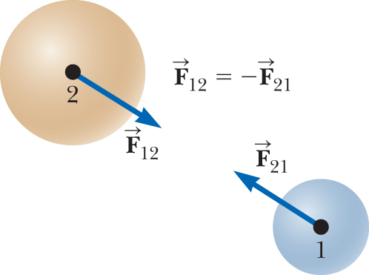
5.4 Newton’s Third Law
Every force has an agent and acts on an object.
Identify the agent and object for each force.
Notes:
Newton’s third law

Slide 37

Newton’s Third Law: Hockey Puck

Slide 38
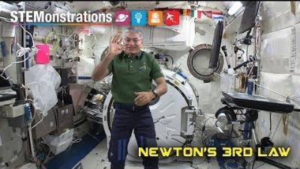
Newton’s Third Law
Newton’s Third Law: Space Station

Slide 39
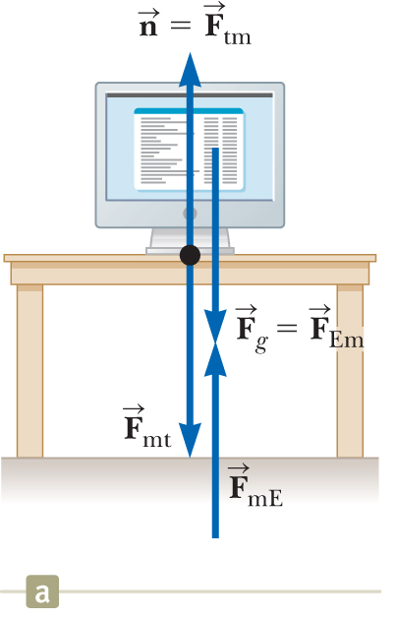
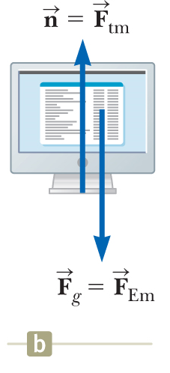













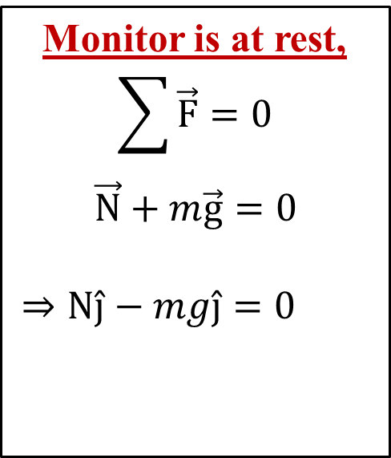
Newton’s Third Law
$$\vec{N}={\vec{F}}_{tm}$$
Monitor is at rest,
$$\sum{\vec{F}}=0$$
$\vec{N}+m\vec{g}=0$
$⇒N\hat{j}−mg\hat{j}=0$
$$\vec{N}={\vec{F}}_{tm}$$
FBD
$$×$$
$$××$$
$$×$$
$$\vec{W}$$
$$××$$
$$N=mg$$
$$\vec{W}={\vec{F}}_{Em}$$
$${\vec{F}}_{tm}=force by table ON monitor$$
$${\vec{F}}_{Em}=force by Earth ON monitor$$
$${\vec{F}}_{mt}=force by monitor ON table$$
$${\vec{F}}_{mE}=force by monitor ON Earth$$
Notes:
Computer monitor at rest on table (figure (a))
Gravitational force on monitor: F_{g} = F_{Em}
Reaction force: F_{mE} = −F_{Em} exerted by monitor on Earth
Monitor does not accelerate → held up by table
Table exerts on monitor upward force n = F_{tm} → normal force (Normal = perpendicular)
In general: whenever object in contact with surface → surface exerts normal force on object
Normal force on monitor can have any value needed, up to point of breaking table
Because monitor has zero acceleration → Newton’s second law: [click to show equation]
Normal force balances gravitational force on monitor → net force on monitor = 0
Reaction force to n = force exerted by monitor downward on table: F_{mt} = −F_{tm} = −n
Forces acting on monitor: F_{g} and n (figure (b))
F_{mE} and F_{mt} exerted on objects other than monitor

Slide 40
ABCD Card
A 2,000 kg truck runs into a fly, which experiences a greater force?
The truck
The fly
The force is the same

Slide 41
CQ#2
A 2,000 kg truck runs into a fly, which experiences a larger acceleration?
The truck
The fly
The force is the same

Slide 42
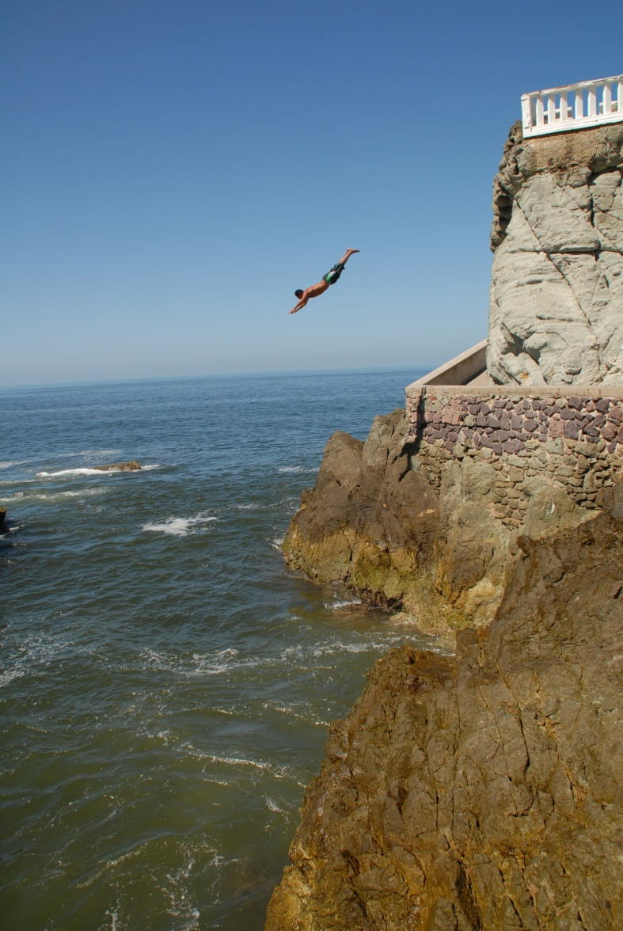
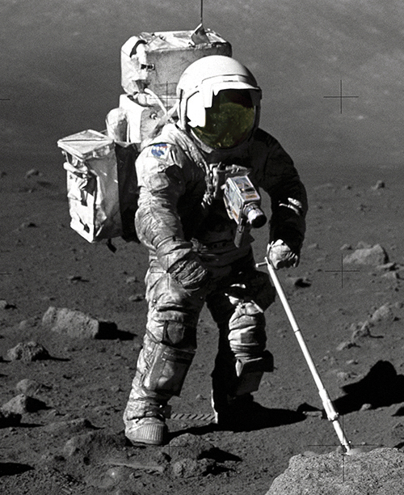
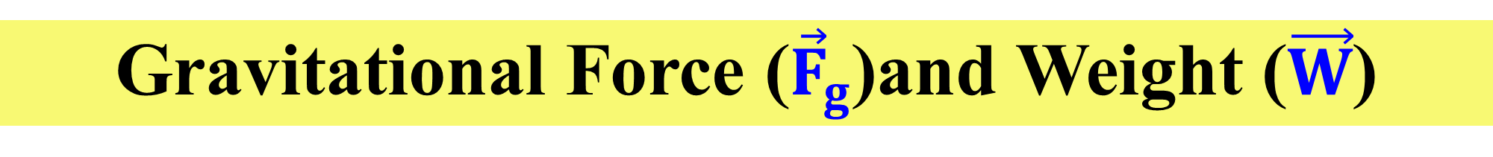

Gravitational Force (${\vec{F}}_{g}$)and Weight ($\vec{W}$)
Gravitational force: attractive force exerted by Earth on object
Directed toward center of Earth
${\vec{F}}_{g} or \vec{W} =m \vec{g}$
g ~ 9.80 m/s²
g varies with geographic location;
g decreases with increasing distance from center of Earth.
Notes:
All objects attracted to Earth
Gravitational force F_{g}: attractive force exerted by Earth on object
Directed toward center of Earth
Magnitude called weight of object
Freely falling object experiences acceleration g acting toward center of Earth
Applying Newton’s second law to freely falling object of mass m: [click to show equation]
Result: [click to show equation]
Weight of object (magnitude of F_{g}): [click to show equation]
Image credit:
https://commons.wikimedia.org/wiki/File%3ACliff_diver.jpg
By Kfengler (Own work) [CC BY 3.0 (http://creativecommons.org/licenses/by/3.0)], via Wikimedia Commons

Slide 43
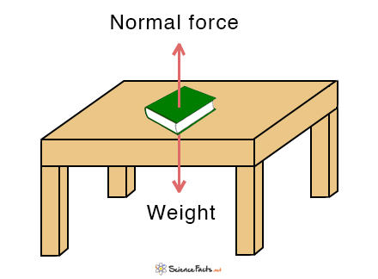


Normal Force ($\vec{N}$)
Definition: the force that surfaces exert to prevent solid objects from passing through each other
Variable:
Unit: Newtons (N)
Equation: No specific equation
N = F_{g} if a_{y} = 0 m/s² (rest or equilibrium)
N ≠ F_{g} if a_{y} ≠ 0 m/s²
Direction: Pointed away from the surface &
perpendicular to the surface
$$\vec{N}$$

Slide 44
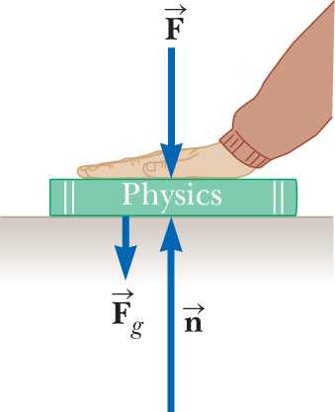
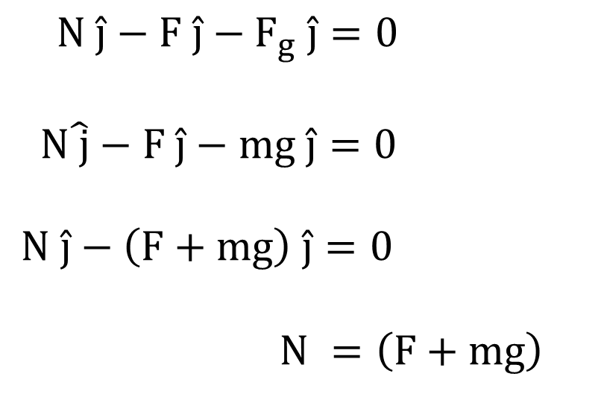
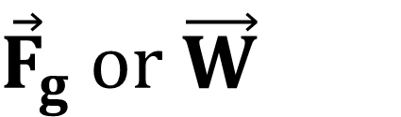
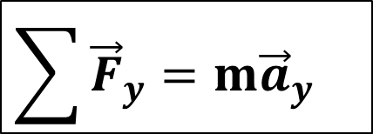



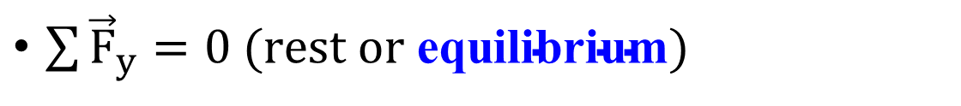
$$\vec{N}$$
$${\vec{F}}_{g} or \vec{W}$$
When is ≠
$$\sum{{\vec{F}}_{y}}=m{\vec{a}}_{y}$$
$\sum{{\vec{F}}_{y}}=0 (rest or \text{equilibrium})$
$N \hat{j}−F \hat{j}−$ $F_{g} \hat{j}=0$
N$\hat{ j}−F \hat{j}−mg \hat{j}=0$
$N \hat{j}−\left(F+mg\right) \hat{j}=0$
$N =\left(F+mg\right)$
$\vec{N}$
$$N≠mg$$

Slide 45
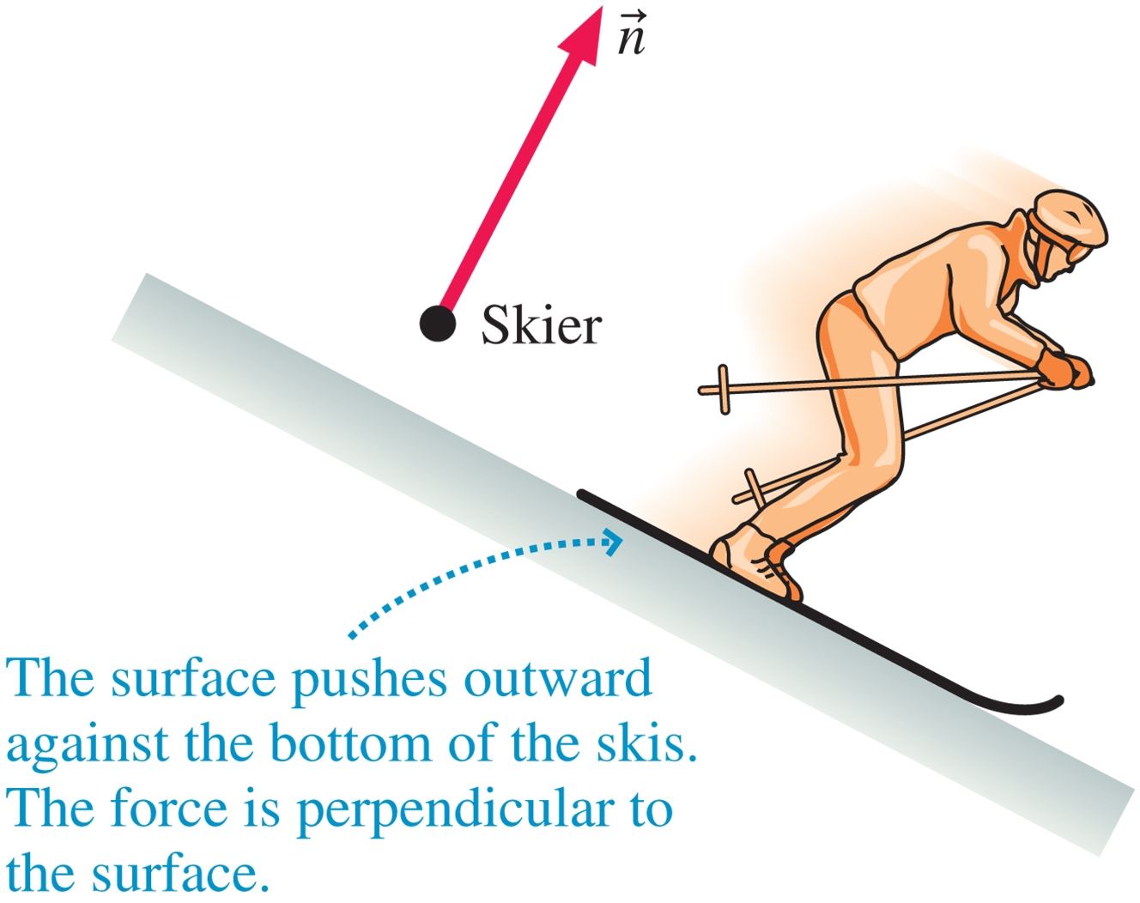

Normal Force (2)
The normal force when the surface is inclined at an angel with the horizontal.
$\vec{N}$

Slide 46
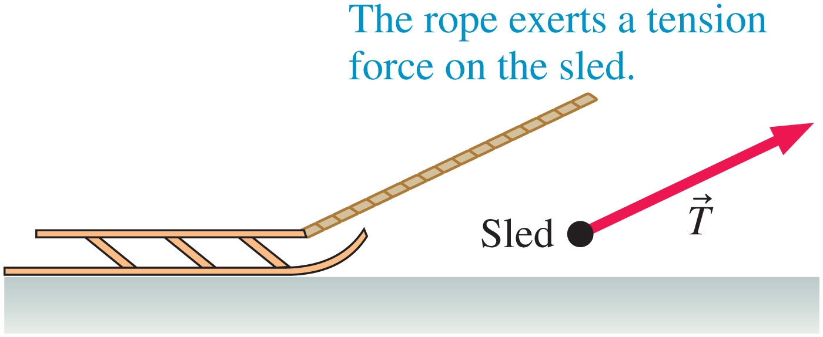


Tension Force ($\vec{T}$)
Definition: a force that develops in a rope, thread, or cable as it is stretched
Variable:
Unit: Newtons (N)
Equation: No specific equation
Either is given or calculated from Newton’s 2nd Law
Direction: Pointed away from force pulling on string
$$\vec{T}$$

Slide 47
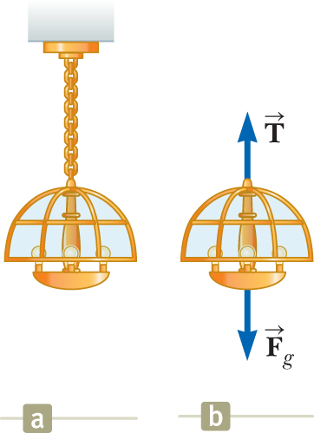
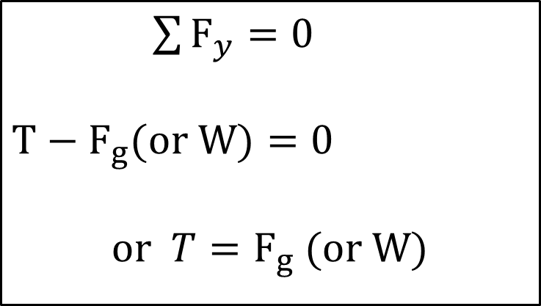
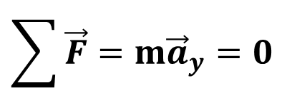

Tension Force
If a = 0: particle in equilibrium model → net force on object = 0
$$\sum{\vec{F}}=m{\vec{a}}_{y}=0$$
$\sum{F_{y}}=0$
$$T−F_{g}(or W)=0$$
$$\text{or }T=F_{g} (or W)$$
$${\vec{F}}_{g} or \vec{W}$$

Slide 48
CQ#3
A 20 kg chandelier hangs from the ceiling. What is the tension in the wire holding up the chandelier?
20 kg
196 N
20 N
Not enough information

Slide 49




Free Body Diagram (FBD)
Inclined plane
$$\vec{N}$$
$$θ$$

Slide 50



  The normal force acts perpendicular to the plane.
  The gravitational force acts straight down.
Choose the coordinate system with x along the incline and y perpendicular to the incline.
Replace the force of gravity with its components.

Slide 51



Spring Force
Spring Force (${\vec{F}}_{s}$)
Springs come in in many forms. When deflected, they push or pull with a spring force.
Hooke’s law:
F_{s} = spring force
k = spring constant
x = spring stretch or compression
Restoring force → always directed toward equilibrium position.

Slide 52
CQ#4
A spring has a spring constant of 50 N/m and is stretched 1 cm. What is the magnitude of spring force?
50 N
5 N
0.5 N
0 N

Slide 53

Free Body Diagram (FBD)
DRAW THE FREE-BODY DIAGRAM OF FORCES
Direction of motion
no friction
Direction of motion
with friction

Slide 54
Free Body Diagram (FBD)
DRAW THE FREE-BODY DIAGRAM OF FORCES
Direction of motion
θ
NO friction
Direction of motion
θ
With friction

Slide 55



Drawing a Free Body Diagram
DRAW THE FREE-BODY DIAGRAM OF FORCES
N
$$\sum{F_{y}}=N−W(F_{g})=0$$
$$\sum{F_{y}}=N−W(F_{g})=0$$
$$\sum{F_{x}}=F=m⋅a_{x}$$
F_{g}
Direction of motion
N
F
no friction
F_{g}
$$\sum{F_{y}}=N−W(F_{g})=0$$
$$\sum{F_{x}}=F−f=m⋅a_{x}$$
N
Direction of motion
f
F
with friction
F_{g}

Slide 56



Drawing a Free Body Diagram
DRAW THE FREE-BODY DIAGRAM OF FORCES
T
$$\sum{F_{y}}=T−W(F_{g})=0$$
F_{g}
Direction of motion
$$\sum{F_{y}}=N−W(F_{g})\cos{θ}=0$$
$$\sum{F_{x}}=W(F_{g})\sin{θ}=m·a_{x}$$
N
θ
x
θ
NO friction
y
F_{g}
Direction of motion
$$\sum{F_{y}}=N−W(F_{g})\cos{θ}=0$$
$$\sum{F_{x}}=W(F_{g})\sin{θ−f}=m·a_{x}$$
N
f
θ
x
With friction
y
F_{g}

Slide 57

Problem solving (Newton’s Law of Motion)
40) As shown in the figure, the block of mass 30.0 kg slides on the frictionless horizontal surface. If the two forces acting on the block are 30.0 N, what is the magnitude of the resulting acceleration of the block?
Answer: 1.87 m/s²

Slide 58




Problem solving (Newton’s Law of Motion)

Slide 59


Slide 60
Problem solving (Newton’s Law of Motion)
A body of mass 2.00 kg is pushed straight upward by a 25.0 N vertical force. What is its acceleration? (Ignore the friction)

Slide 61





Problem solving (Newton’s Law of Motion)

Slide 62
Example: The Runway
A car of mass m is on an icy driveway inclined at an angle θ as in the figure.
(A) Find the acceleration of the car, assuming the driveway is frictionless.
Notes:
Conceptualize Use the figure to conceptualize the situation. From everyday experience, we know that a car on an icy incline will accelerate down the incline. (The same thing happens to a car on a hill with its brakes not set.)
Categorize We categorize the car as a particle under a net force because it accelerates. Furthermore, this example belongs to a very common category of problems in which an object moves under the influence of gravity on an inclined plane.

Slide 63




Example: The Runway
From Newton’s 2nd Law along x-axis,
$$\sum{F_{x}=mg\sin{θ}=ma_{x}}…(1)$$
$$\vec{N}$$
From Newton’s 2nd Law along y-axis,
$$\sum{F_{y}=N−mg\cos{θ}=ma_{y}…(2)}$$
From equation (1)
$$a_{x}=g\sin{θ}…(3)$$
Notes:
Analyze Shown is the free-body diagram for the car. The only forces acting on the car are the normal force n exerted by the inclined plane, which acts perpendicular to the plane, and the gravitational force F_{g} = mg, which acts vertically downward. For problems involving inclined planes, it is convenient to choose the coordinate axes with x along the incline and y perpendicular to it as in the figure. Using similar triangles, we can show that the angle between the gravitational force F_{g} and the negative y axis in this figure is equal to the angle θ that the incline makes with the horizontal in part (a). With these axes, we represent the gravitational force by a component of magnitude mg sinθ along the positive x axis and one of magnitude mg cos θ along the negative y axis. Our choice of axes results in the car being modeled as a particle under a net force in the x direction and a particle in equilibrium in the y direction.
Apply these models to the car. [click to show equations]
Solve the first equation for a_{x}. [click to show equation]
Finalize Note that the acceleration component a_{x} is independent of the mass of the car! It depends only on the angle of inclination and on g. From Equation (2), we conclude that the component of F_{g} perpendicular to the incline is balanced by the normal force; that is, n = mg cosθ. This situation is a case in which the normal force is not equal in magnitude to the weight of the object. It is possible, although inconvenient, to solve the problem with “standard” horizontal and vertical axes. You may want to try it, just for practice.

Slide 64
Example: The Runway
(B) Suppose the car is released from rest at the top of the incline and the distance from the car’s front bumper to the bottom of the incline is d. How long does it take the front bumper to reach the bottom of the hill, and what is the car’s speed as it arrives there?
Notes:
Conceptualize Imagine the car is sliding down the hill and you use a stopwatch to measure the entire time interval until it reaches the bottom.
Categorize This part of the problem belongs to kinematics rather than to dynamics, and the acceleration a_{x} is constant. Therefore, you should categorize the car in this part of the problem as a particle under constant acceleration.

Slide 65






Example: The Runway
$$B \left(i\right) x=x_{0}+v_{0x}t+\frac{1}{2}a_{x}t^{2}→d=\frac{1}{2}a_{x}t^{2}$$
$$t=\sqrt{\frac{2d}{a_{x}}}=\boxed{\sqrt{\frac{2d}{g\sin{θ}}}}$$
$$\vec{N}$$
From equation (1)
$${B \left(ii\right) v_{x}}^{2}={v_{0x}}^{2}+2a_{x}d$$
$${v_{x}}^{2}=2a_{x}d$$
$$v_{x}=\sqrt{2a_{x}d}=\boxed{\sqrt{2gd\sin{θ}}}$$
From equation (1)
Notes:
Analyze Defining the initial position of the front bumper as x_{i} = 0 and its final position as x_{f} = d, and recognizing that v_{xi} = 0, choose this equation [click to show equation] from the particle under constant acceleration model:
Solve for t. [click to show equation]
Use the time-independent kinematic equation, with v_{xi} = 0, to find the final velocity of the car. [click to show equation]
Finalize We see from that the time t at which the car reaches the bottom and its final speed v_{xf} are independent of the car’s mass, as was its acceleration. Notice that we have combined techniques from Chapter 2 with new techniques from this chapter in this example. As we learn more techniques in later chapters, this process of combining analysis models and information from several parts of the book will occur more often. In these cases, use the Analysis Model Approach to Problem-Solving to help you work your way through new problems.

Slide 66


Example 3a: Mass at Rest
A system of two cables supports a 100 N ball as shown. What is the tension on the right cable?
Answer = 200 N
Notes:
Conceptualize Inspect the drawing. Let us assume the cables do not break and nothing is moving.
Categorize If nothing is moving, no part of the system is accelerating. We can now model the light as a particle in equilibrium on which the net force is zero. Similarly, the net force on the knot that holds the cables together is zero, so it is also modeled as a particle in equilibrium.

Slide 67



Example 3a: Mass at Rest
Notes:
Conceptualize Inspect the drawing. Let us assume the cables do not break and nothing is moving.
Categorize If nothing is moving, no part of the system is accelerating. We can now model the light as a particle in equilibrium on which the net force is zero. Similarly, the net force on the knot that holds the cables together is zero, so it is also modeled as a particle in equilibrium.

Slide 68



Example 3a: Mass at Rest
A system of two cables supports a 14.0 kg ball as shown. What is the tension on the right cable?
Answer = 120 N
Notes:
Conceptualize Inspect the drawing. Let us assume the cables do not break and nothing is moving.
Categorize If nothing is moving, no part of the system is accelerating. We can now model the light as a particle in equilibrium on which the net force is zero. Similarly, the net force on the knot that holds the cables together is zero, so it is also modeled as a particle in equilibrium.

Slide 69









Example 3a: Mass at Rest
Notes:
Conceptualize Inspect the drawing. Let us assume the cables do not break and nothing is moving.
Categorize If nothing is moving, no part of the system is accelerating. We can now model the light as a particle in equilibrium on which the net force is zero. Similarly, the net force on the knot that holds the cables together is zero, so it is also modeled as a particle in equilibrium.

Slide 70

Example: Weighing a Fish in an Elevator
A person weighs a fish of mass m on a spring scale attached to the ceiling of an elevator as illustrated in the figure.
(A) Show that if the elevator accelerates either upward or downward, the spring scale gives a reading that is different from the weight of the fish.
Notes:
Conceptualize The reading on the scale is related to the extension of the spring in the scale, which is related to the force on the end of the spring as in the figure. Imagine that the fish is hanging on a string attached to the end of the spring. In this case, the magnitude of the force exerted on the spring is equal to the tension T in the string. Therefore, we are looking for T. The force T pulls down on the spring and pulls up on the fish.
Categorize We can categorize this problem by identifying the fish as a particle in equilibrium if the elevator is not accelerating or as a particle under a net force if the elevator is accelerating.

Slide 71







Example: Weighing a Fish in an Elevator
$$Case 1 \left(\text{If elevator at }\text{rest}\text{ or }\text{moving}\text{ with constant }v\right)$$
$$\sum{F_{y}}=0$$
$$T−F_{g}=0$$
$$T=F_{g}=mg$$
$$Case 2 \left(\text{If} \text{elevator }is accelerating up or down\right)$$
$$\sum{F_{y}}=ma_{y}$$
$$T−mg=ma_{y}$$
$$T=mg+ma_{y}$$
$$accelerating upward a_{y}=positive$$
$$T=mg−ma_{y}$$
$$accelerating downward a_{y}=negative$$
Notes:
Analyze Inspect the diagrams of the forces acting on the fish and notice that the external forces acting on the fish are the downward gravitational force F_{g} = mg and the force T exerted by the string. If the elevator is either at rest or moving at constant velocity, the fish is a particle in equilibrium, so [click to show equation]
(Remember that the scalar mg is the weight of the fish.)
Now suppose the elevator is moving with an acceleration a relative to an observer standing outside the elevator in an inertial frame. The fish is now a particle under a net force.
Apply Newton’s second law to the fish. [click to show equation]
Solve for T, [click to show equation] where we have chosen upward as the positive y direction. We conclude from our result that the scale reading T is greater than the fish’s weight mg if a is upward, so a_{y} is positive, and that the reading is less than mg if a is downward, so a_{y} is negative.

Slide 72









Example: Weighing a Fish in an Elevator
(B) Evaluate the scale readings for a 40.0 N fish if the elevator moves with an acceleration a_{y} = ± 2.00 m/s².
$$F_{g}=mg=40.0 N$$
$$⇒m=\frac{40.0 N}{g}=\frac{40.0 N}{9.80}=4.08 kg$$
$$accelerating upward a_{y}=positive$$
$$accelerating downward a_{y}=negative$$
$$T=mg+ma_{y}$$
$$T=mg−ma_{y}$$
$$=40.0+4.08 (2.00)$$
$$=40.0−4.08 (2.00)$$
$$T=\boxed{48.2​\text{ N}}$$
$$T=\boxed{31.8​\text{ N}}$$
Notes:
Evaluate the scale reading if a is upward. [click to show equation]
Evaluate the scale reading if a is downward. [click to show equation]
Finalize Take this advice: if you buy a fish by weight in an elevator, make sure the fish is weighed while the elevator is either at rest or accelerating downward! Furthermore, notice that from the information given here, one cannot determine the direction of the velocity of the elevator.

Slide 73











Example: Apparent weight
Notes:
Evaluate the scale reading if a is upward. [click to show equation]
Evaluate the scale reading if a is downward. [click to show equation]
Finalize Take this advice: if you buy a fish by weight in an elevator, make sure the fish is weighed while the elevator is either at rest or accelerating downward! Furthermore, notice that from the information given here, one cannot determine the direction of the velocity of the elevator.

Slide 74


Apparent Weight
Consider the scale in the elevator in the figure below. The apparent weight of an object is the reading of the scale. It is equal to the normal force the man exerts on the scale.
To determine the apparent weight, solve for the normal force.

Slide 75





Free Body Diagram (FBD)
An object rests on an incline that makes an angle $θ$ with the horizontal.
$$w_{x}=w sin θ=mg sin θ$$
$$w_{y}=w cos θ=mg cos θ$$
Notes:
Figure (a): figure shows many of the forces in situation:
those acting on monitor, one acting on table, and one acting on Earth
Figure (b): only forces acting on one object (monitor): force diagram
Figure (c): free-body diagram → particle model used by representing object as dot and showing forces that act on object applied to dot
Free-body diagram helps isolate only forces on object and eliminate other forces from our analysis

Slide 76
Summary: Newton’s Law
Check the Learning Goals
Newton’s 1st & 2nd Laws
  Draw and interpret a free-body diagram.
  Describe the consequences of no force or balanced forces on an object.
  Write Newton’s 2nd Law for a physical scenario.
  Use Newton’s 2nd Law to solve a problem
    With balanced forces.
    With unbalanced forces.
  Use Newton’s Laws to predict the motion of an object.
Other Forces and Newton’s 3rd Laws
  Use Newton’s 3rd Law to Identify force pairs.
  Solve a problems involving static friction, kinetic friction, gravity, tension, and normal force.

